Slide 1
Case Study: Privileged Access and Data Science
Mike MacIntyre | VP of Product, Panaseer
03/22/19

Slide 2
Outline
Framing the problem
Introduction to CCM
Building the Graph
Simple Measures
Next steps

Slide 3
The story so far…
BOARD SCRUTINY
Departing board member asks CISO to demonstrate control over privilege access in the company before leaving the business in 18 months time

Slide 4

“It’s just not possible” - PAM was in a state of panic

Slide 5

Customer Approach
Rank Business applications
How complete is your CMDB?
Focus on Crown Jewel application stack
Define Control set for Crown Jewels
Strongest & most comprehensive
Establish ground truth
Increase visibility on privilege allocation
Clean up Privilege
Track progress
Optimise number of Humans with Crown Jewel privileges
Minimise number of privilege inheritance paths
Continuously monitor
Expand to next set of critical applications
Reduce control set
“I’m an admin!”…”No, I’m an admin!”.. Frank was a film buff and knew exactly what this lot were playing at​

Slide 6
Fundamental layers for achieving effective CCM
Data collection
Automatic data collection of technical controls thru APIs/logs, into central repo
Asset inventories
Create trusted inventories triangulated from multiple sources of data
Measurement
Automatically populate measures against SLA and other target thresholds
Continuous Control Monitoring
Continuously monitor and measure controls against SLAs in multiple security frameworks
Data unification
Data cleaning correlation, normalization, aggregation and modelling
`
Control coverage
Check Control Coverage against asset inventories to identify and fill gaps
Controls catalogue and frameworks
Automatically populate any security framework any time
CCM
Controls catalogue and frameworks
Value
Security measurement
Control coverage analysis
Asset inventories
Data unification
Automatic data collection

Slide 7



Building the Graph
Asset Inventory
Local Admin
Identity & Access Management
HR
Authentication Services
Database logs
Applications logs
CMDB
Spreadsheet
Endpoint Agent
Vulnerability Scans
Line Management
Role
Active Directory
Application
Database
Server

Slide 8
Building an Inventory
Discovery tools
Nmap
Network
Netflow
Endpoint Agent
Tanium
Configuration management/Patching
SCCM
Authentication Services
AD
CMDB discovery modules
Vuln Scanner
Windows event logs
DHCP
OSQuery
AV
BigFix
Read more
https://panaseer.com/2017/10/19/inventory-management/

Slide 9
Building an Inventory
Assets in need of management
Active Directory
Config Mgmt
Discovery Scanner
CMDB
Endpoint
Agent

Slide 10
Building the Graph
Asset Inventory
Local Admin
Identity & Access Management
HR
Authentication Services
Database logs
Applications logs
CMDB
Spreadsheet
Endpoint Agent
Vulnerability Scans
Line Management
Role
Active Directory
Server

Slide 11


Building the Graph
Asset Inventory
Local Admin
Identity & Access Management
HR
Authentication Services
Database logs
Applications logs
CMDB
Spreadsheet
Endpoint Agent
Vulnerability Scans
Line Management
Role
Active Directory
Account
Server
Group

Slide 12




Building the Graph
Asset Inventory
Local Admin
Identity & Access Management
HR
Authentication Services
Database logs
Applications logs
CMDB
Spreadsheet
Endpoint Agent
Vulnerability Scans
Line Management
Role
Active Directory
Organisation
Employee
Account
Server
Group

Slide 13


Building the Graph
Asset Inventory
Local Admin
Identity & Access Management
HR
Authentication Services
Database logs
Applications logs
CMDB
Spreadsheet
Endpoint Agent
Vulnerability Scans
Line Management
Role
Active Directory
Organisation
Employee
Account
Server
Group
Account
Group

Slide 14
Building the Graph
Asset Inventory
Local Admin
Identity & Access Management
HR
Authentication Services
Database logs
Applications logs
CMDB
Spreadsheet
Endpoint Agent
Vulnerability Scans
Line Management
Role
Active Directory
Organisation
Employee
Account
Server
Group
Employee
Account
Group

Slide 15
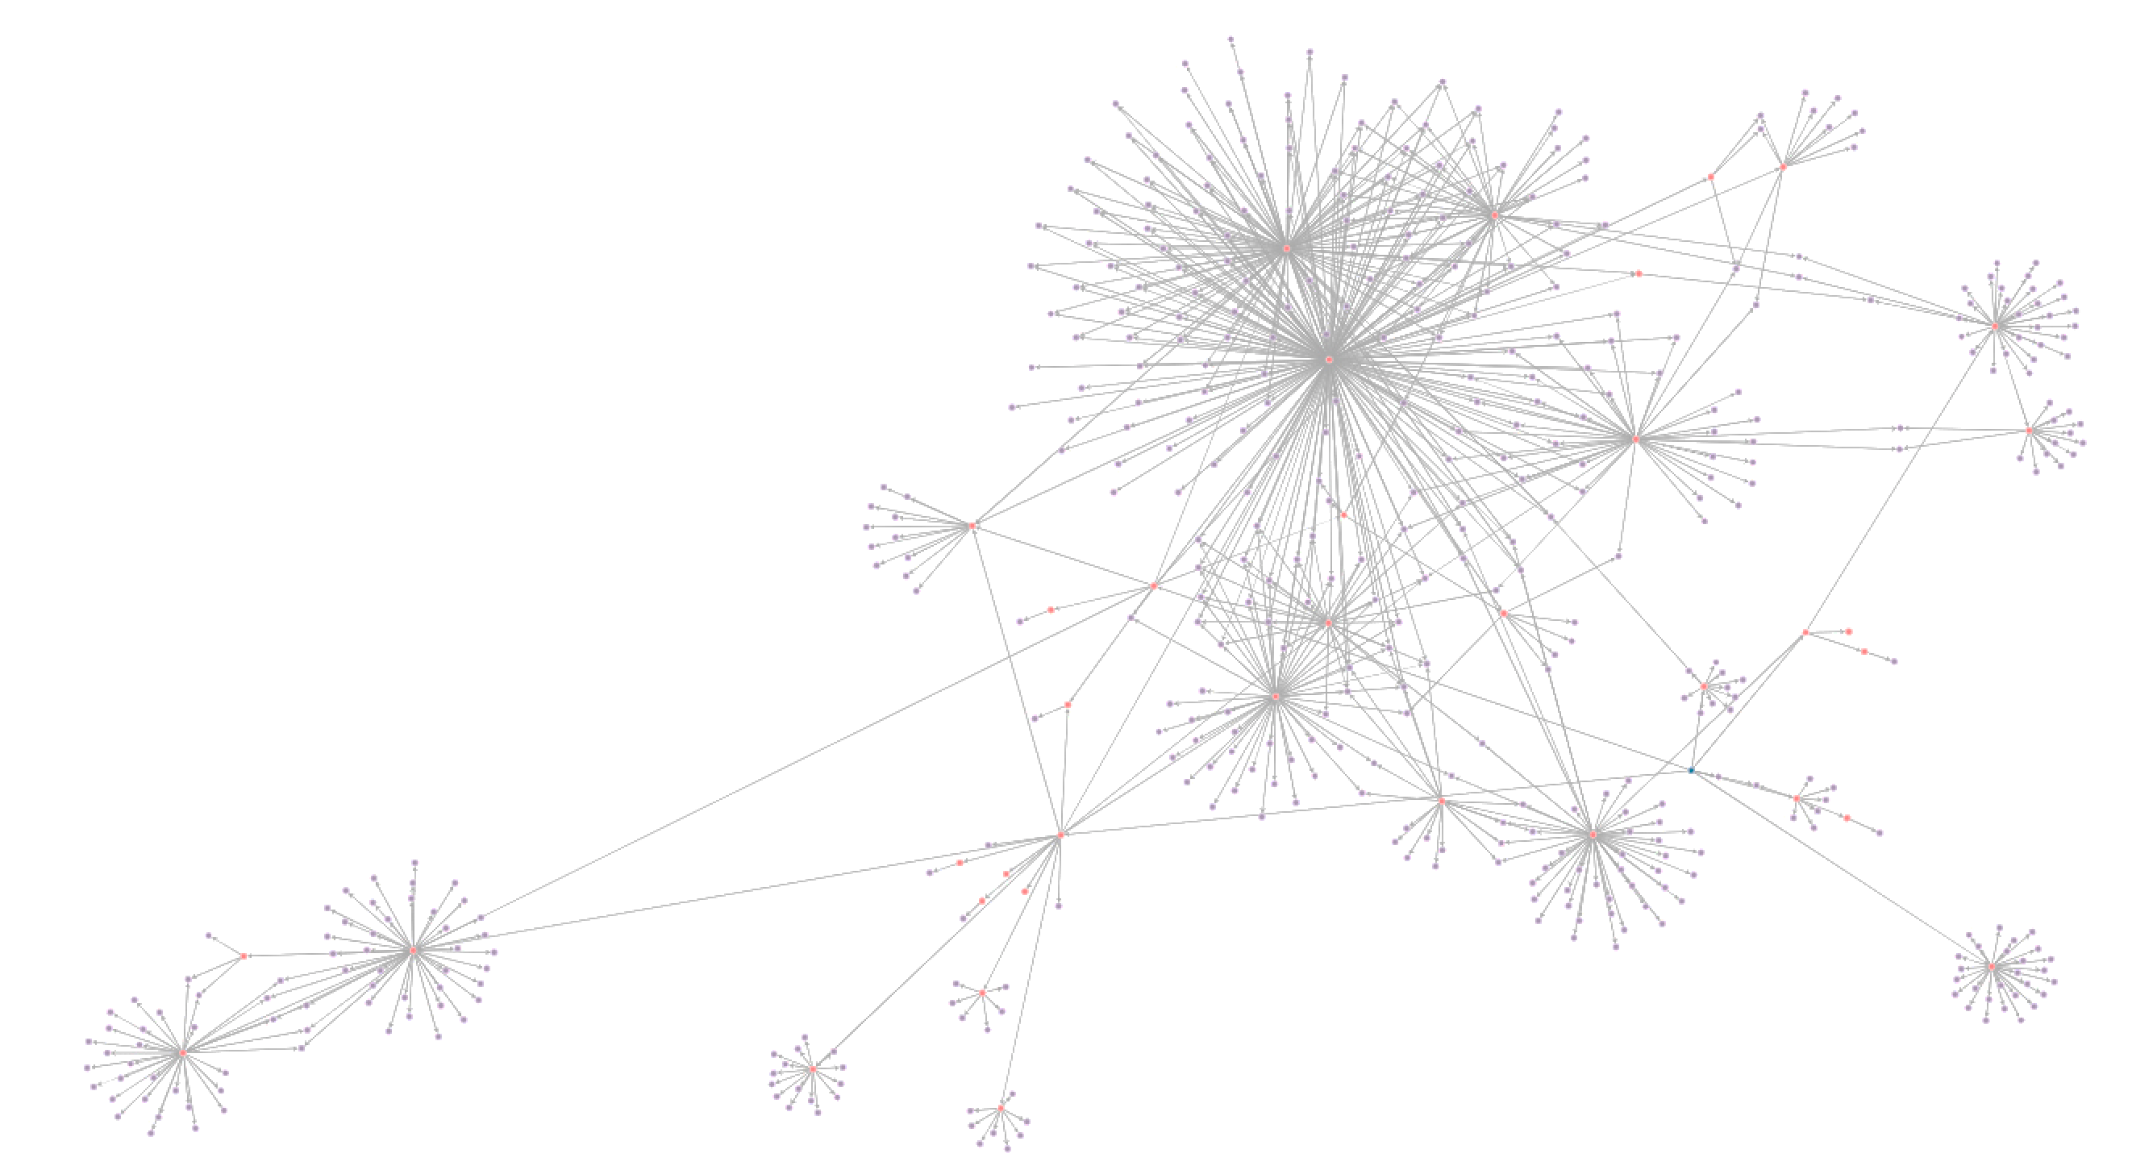
The reality of a “Critical” system

Slide 16
Simple Graph Measures
Number of devices with no graph!
Number of Accounts with Direct Privileged Access
Include classification of account type
Number of Accounts with inherited Privileged Access
Via group membership
Include classification of account type
Number of Humans with Access
Does this map 1:1 with accounts?
Number of Paths to Privileged Access
How many are approved?

Slide 17
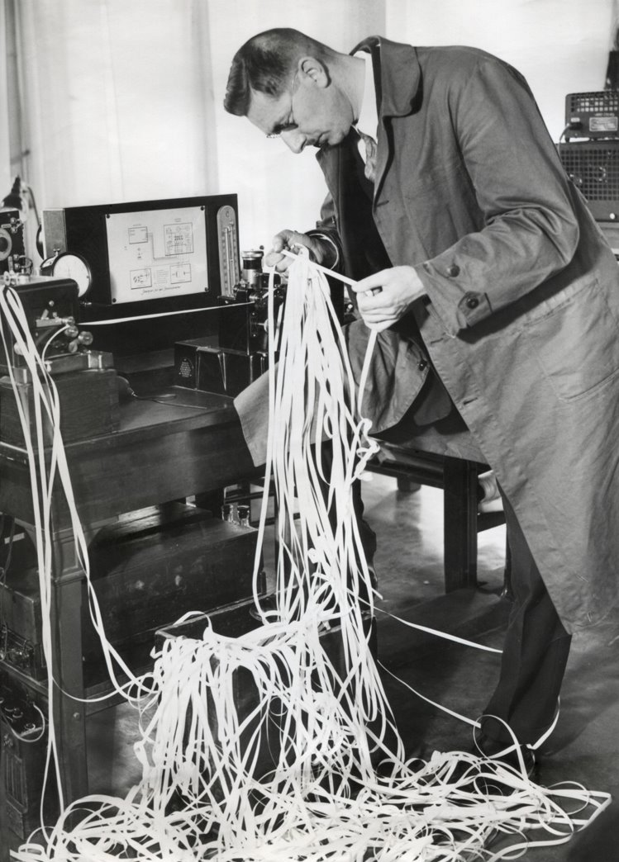
Untangling Permissions
Before we can remove privileged access…
Is this account vaulted?
Is direct privilege appropriate for this account?
Is this account privileged through an alternative path?
Is it appropriate for this group to permit privilege?
Is this group granting privilege to additional services?
Does this Human need this privilege?
Is there anyone that should have this privilege but doesn’t?
Terry had been searching for correctly assigned admin permissions since 1957.​

Slide 18

Extending the Graph
Asset Inventory
Local Admin
Identity & Access Management
HR
Authentication Services
Database logs
Applications logs
CMDB
Spreadsheet
Endpoint Agent
Vulnerability Scans
Line Management
Role
Active Directory
Quest
Direct Access
SQLServer, Oracle
Organisation
Application
Employee
Database
Account
Server
Group
Employee
Account
Group

Slide 19
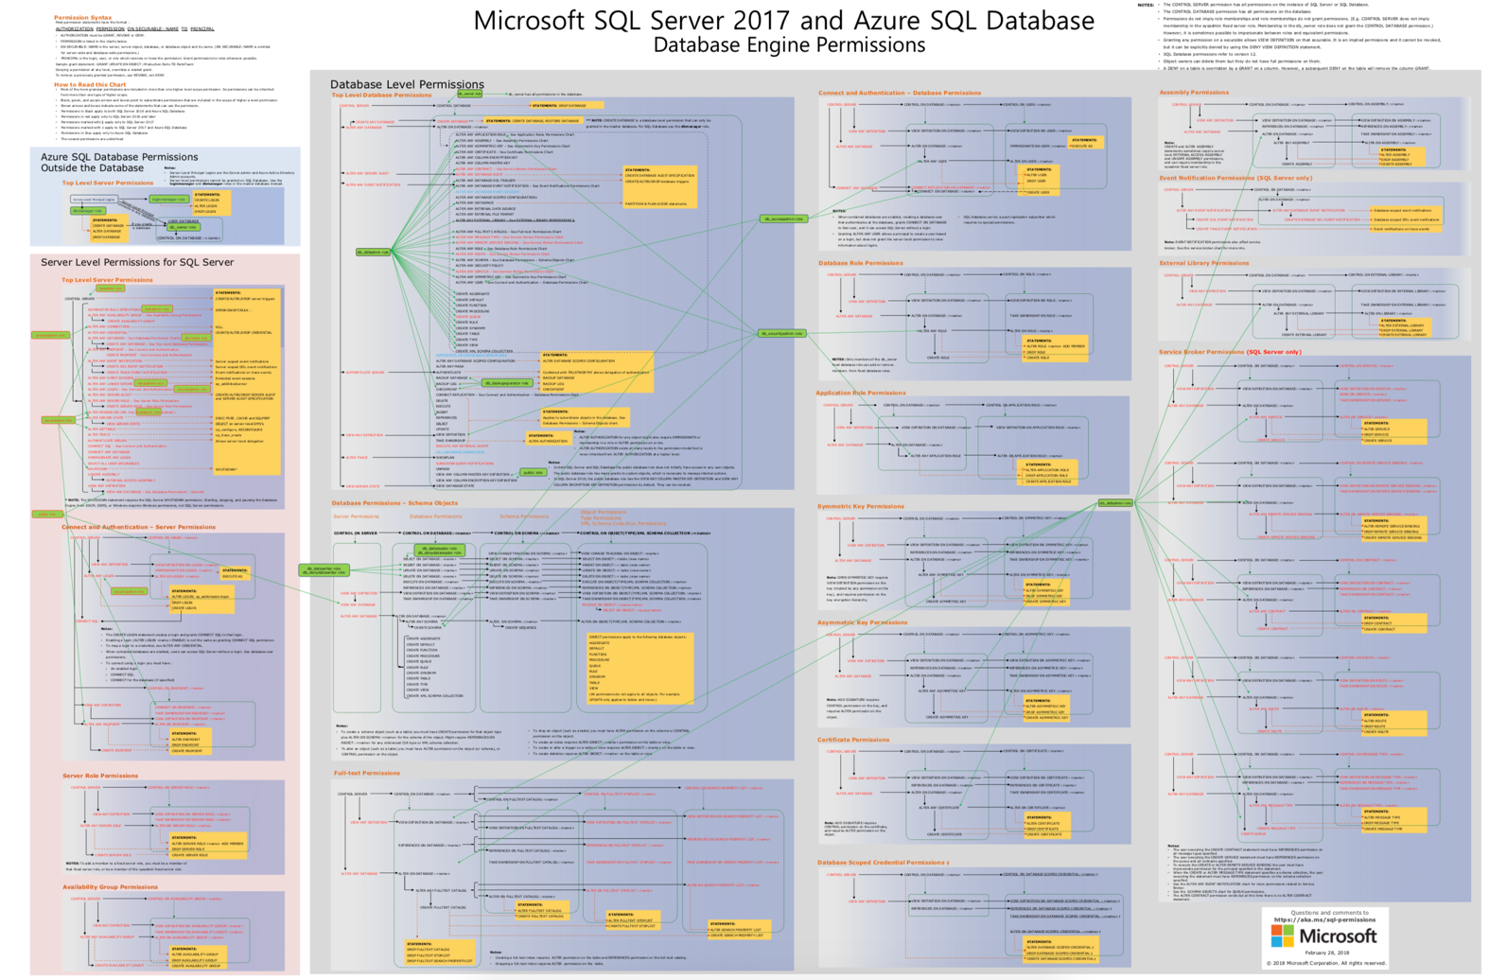
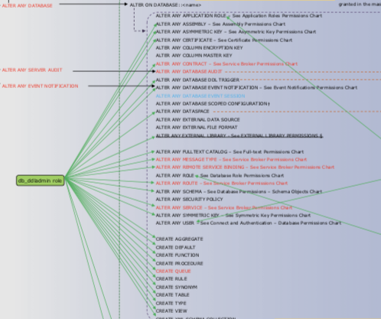
SQL Server Database Permissions

Slide 20
What did we achieve?
Comprehensive visibility of Privilege across critical systems within the organisation
Automated, continuous Privilege Access analysis for multiple platforms
Windows & Linux Servers
Oracle & SQL Server DBs
Applications - coming soon
Demonstrable progress in reducing privilege on critical systems
Organisation
Application
Employee
Database
Account
Server
Group

Slide 21
How could we be more helpful?
Augmented Analytics – Decision Support
Clean-up recommendations
Graph Exploration tooling
Which graph (aka system) is higher risk?
Where to start clean up
How to make this scalable?
Crown Jewel systems – 20’s
Key Systems – 100’s
How to embed this in to a continuous process?
Avoid drift as the organization evolves
Additional data sources?
Was this a valuable activity to undertake?
What are other approaches?

Slide 22
Expanding the Controls
Asset Inventory
Local Admin
Identity & Access Management
HR
Authentication Services
Database logs
Applications logs
CMDB
Spreadsheet
Endpoint Agent
Vulnerability Scans
Line Management
Role
Active Directory
Quest
Direct Access
SQLServer, Oracle
Organisation
Application
Employee
Database
Account
Server
Group
Employee
Account
Group

Slide 23
Fundamental layers for achieving effective CCM
Data collection
Automatic data collection of technical controls thru APIs/logs, into central repo
Asset inventories
Create trusted inventories triangulated from multiple sources of data
Measurement
Automatically populate measures against SLA and other target thresholds
Continuous Control Monitoring
Continuously monitor and measure controls against SLAs in multiple security frameworks
Data unification
Data cleaning correlation, normalization, aggregation and modelling
`
Control coverage
Check Control Coverage against asset inventories to identify and fill gaps
Controls catalogue and frameworks
Automatically populate any security framework any time
CCM
Controls catalogue and frameworks
Value
Security measurement
Control coverage analysis
Asset inventories
Data unification
Automatic data collection

Slide 24
Thank you
mike.macintyre@panaseer.com
@theTechRunner
www.panaseer.com
© 2019 Panaseer Limited

